Slide 1
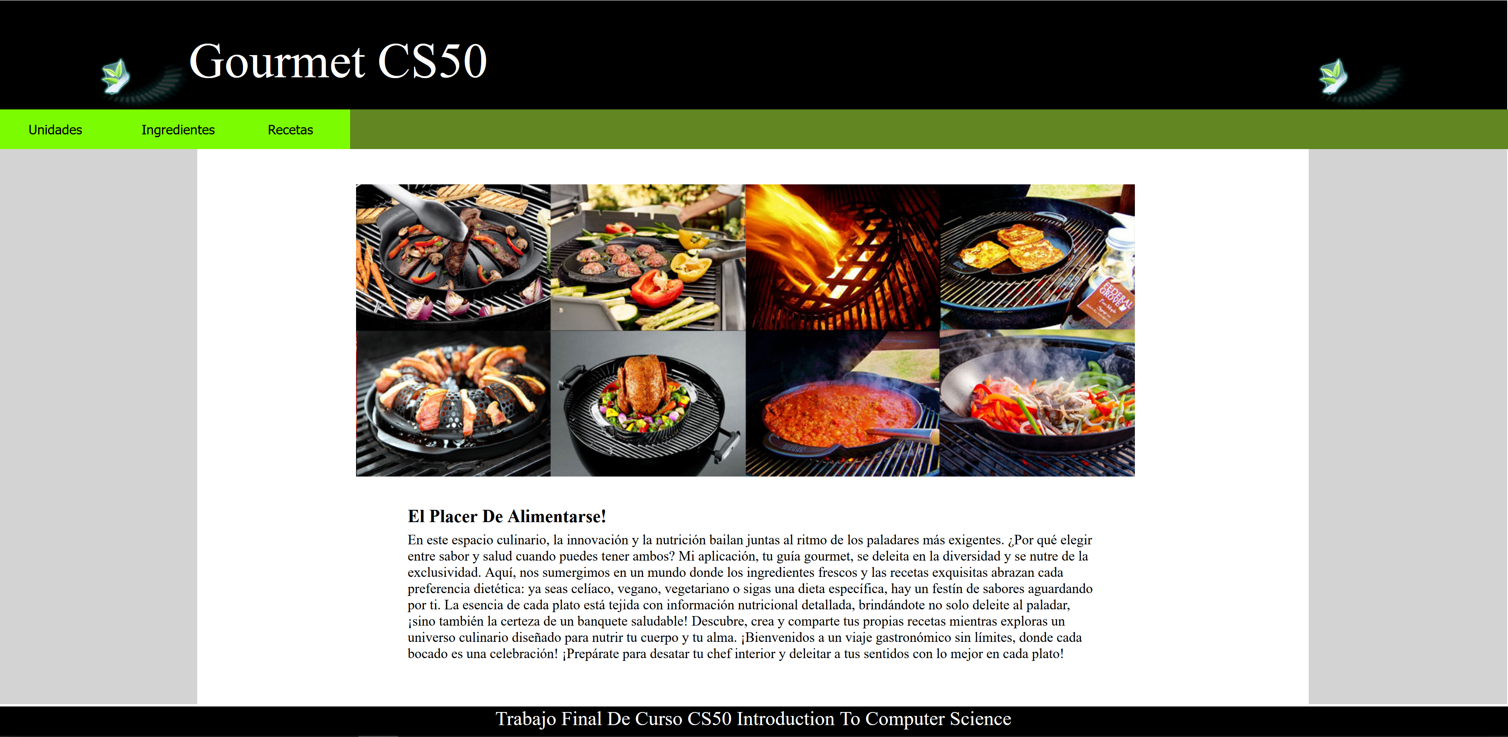
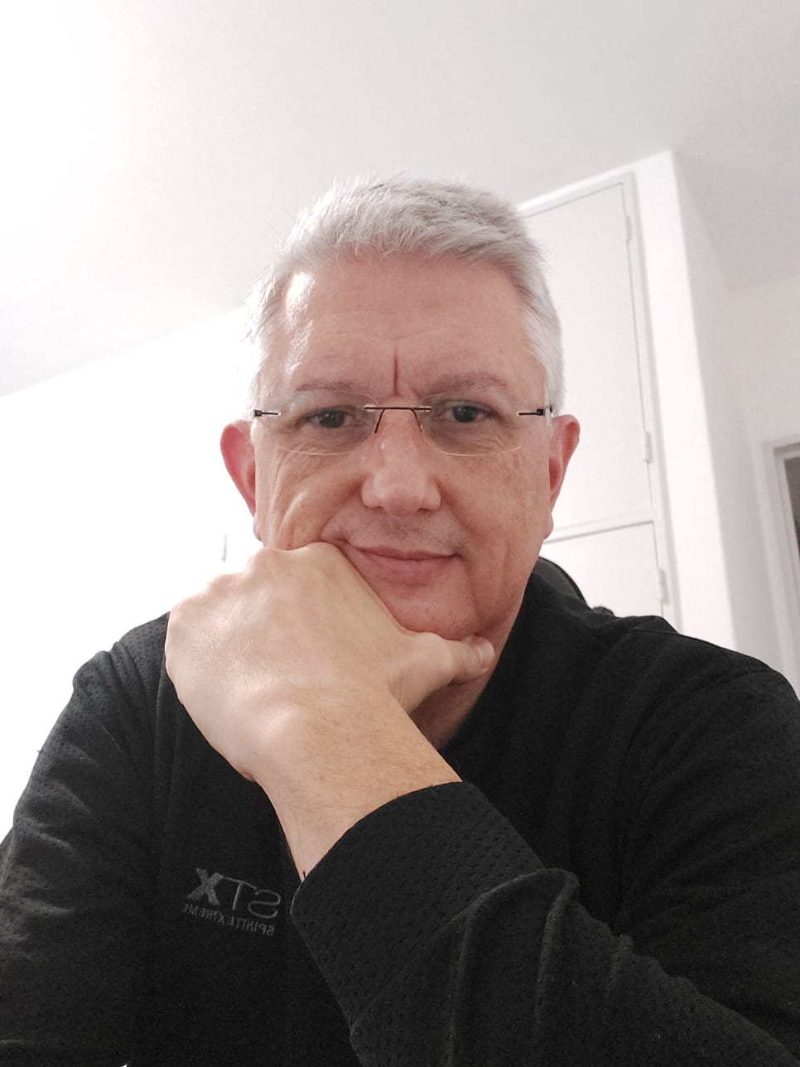
Course final assignment
December 2023
Proyect: Gourmet CS50
Name: Alejandro Vico
City: Córdoba
Country: Argentina
CS50 Introduction to Computer Science

Slide 2
Objective
December 2023
- Develop an application that uses the tools learned in the CS50 Introduction to Computer Science course.
CS50 Introduction to Computer Science

Slide 3
Product: Gourmet CS50
December 2023
Need: due to health issues I have always paid attention to certain characteristics of food when eating, such as fats, sodium, carbohydrates, etc.
Objective: to develop a cooking recipes app that allows to control not only the cost per dish but also the amounts of fat, sodium, etc. in each dish.
Tools: html, CSS, Javascript, Flask (Python) and SQLight3 were used for this development.
CS50 Introduction to Computer Science

Slide 4
December 2023
Product: Gourmet CS50
Database Structure
Units
Types of recipes
1
1
Ingredients
Recipes
n
1
1
n
Ingredients by Recipe
n
n
CS50 Introduction to Computer Science

Slide 5
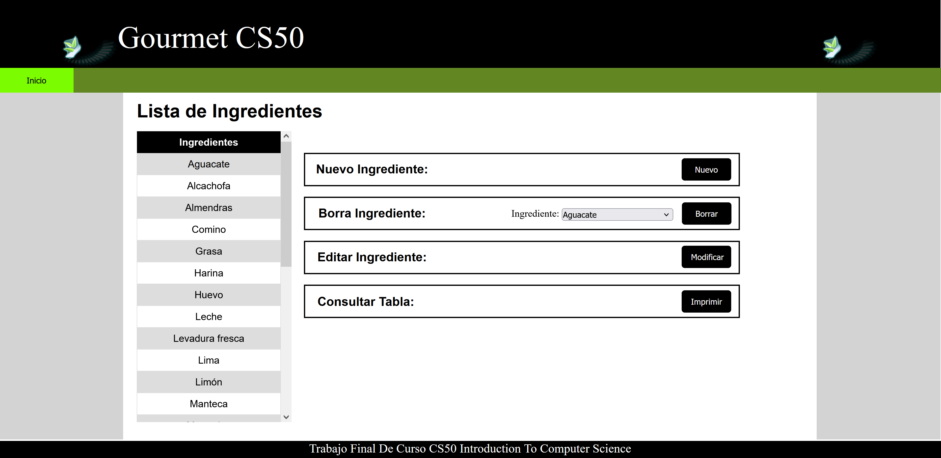
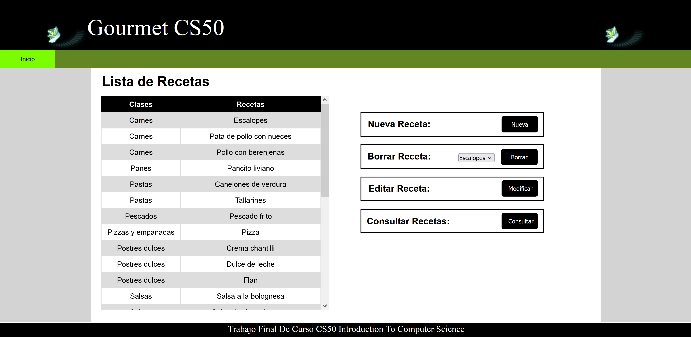
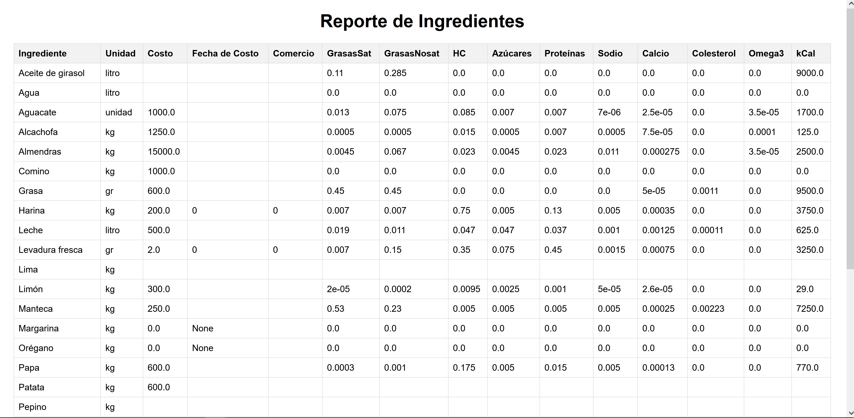
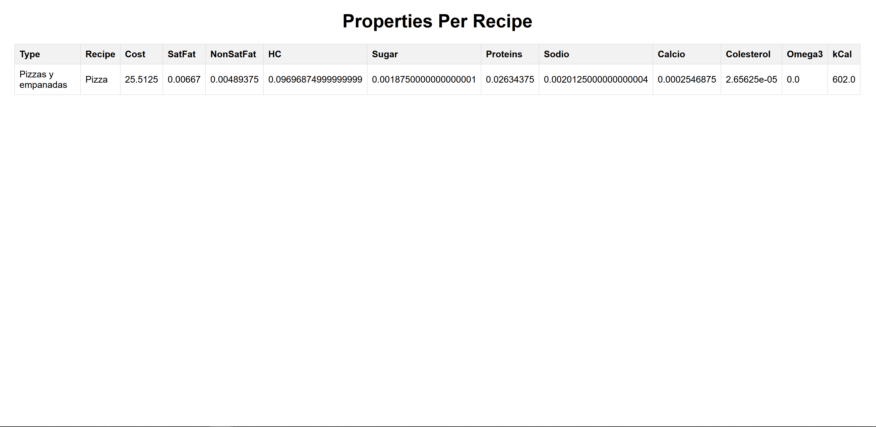
Course final assignment
December 2023
CS50 Introduction to Computer Science

Slide 6
December 2023
Product: Final Query
CS50 Introduction to Computer Science

Slide 7
December 2023
Course: Thanks
THE END
CS50 Introduction to Computer Science

